Slide 1
GSO PO On SupplierNet

Slide 2
Agenda
Executive Summary
Our understanding of Scope
Solution Approach & Activities In scope
Timelines
Pricing
Assumptions & Dependencies
Risks & Mitigations

Slide 3
Executive Summary
Engagement Overview
Providing Online Access for Import Vendors to Submit invoice against the ASN submitted by freight forwarders
By addressing this facility ,import vendor is able to submit invoice in SupplierNet
Solution Summary
Web methods has to identify up only the Non EDI Compatible records and submits the records to the Vendor Portal Database.
Processed ASN application records in the new inbound folder should be moved to a Backup folder as-is in current system.
An alert email has to be sent to the Vendor after the ASN updates to the database.
When the ‘Import Vendor’ clicks on ‘Submit Invoice’ Button in DC_PO_ASN application, application has to compare the PO record and the ASN records .
If there are any variances those details should be updated into a single table in the database.
After generating the report an email has to be sent to “Accounting Team Users”.
A new link should be added for the Exception reports along with the existing report links.
Accounting Team Users’ only will have access to these reports.
When any of the Accounting users clicks on the Exception Report link, page should be displayed with filters.
User should able to view the reports based on the filters (for ex: Vendor No, ASN, and PO No).
The generated report should display in the same page as-is like existing reports

Slide 4
Our understanding of Scope
In-Scope
Web methods has to identify the Non EDI Compatible ASN records and submits the all those records to the Vendor Portal Database.
In DC_PO_ASN Application ,when the Import Vender creates invoice the difference between ASN and PO should be identified and the exceptions should be updated in Database.
Accounting users should able to view the Exception Reports in the supplier net portal.
An alert email has to be sent to the ‘Accounting User’s after the export report generation.
An alert email has to be sent to the Vendor after the ASN updation to the database.
Out-of-Scope
Changes to the PO& T System are not-in scope.
File transfers using EDI from PO&T System to Web method server is not in scope.
Help Files Changes are not in scope
Troubleshooting or modifying upstream or downstream systems
Installation and setup of tools required for the development or testing

Slide 5
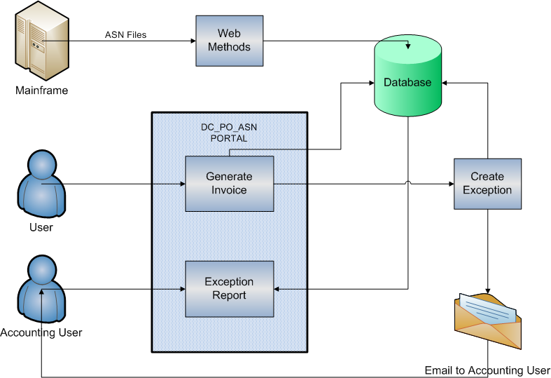
Solution Approach

Slide 6
Activities In Scope
Activities in scope for webMethods
Identification of the non-EDI-compliance ASN records
Insert the ASN records into the relevant tables in the portal DB
Move the ASN files into the backup folder in webMethods server
If there are any ASN Header updates,webMethods will only update the respective ASN header
Activities in scope for Java
Create the new report page with the same look and feel as existing DC_PO_ASN reports.
Link to this report page should be available along with existing reports.
When the import vendor clicks on ‘Submit Invoice’ button in the Create Invoice page , the difference between ASN and PO should be compared and the differences should be stored in new table in Portal DB. After the exception report is (Exception related to PO)is created, an alert email has to be sent to Vendor.
When the Accounting users login , they should able to view the reports using respective filters.
An alert email has to be sent to the Vendor after the ASN records updated to the Database.

Slide 7
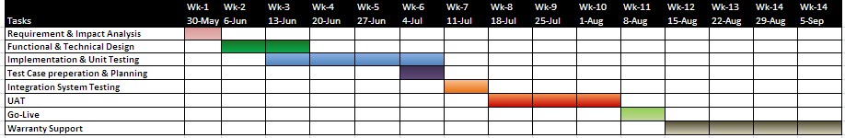
Timeline
Date & Duration
Note: This plan is based on project start date as 30-May-2011.Any delay in the project start date will impact the cost and schedule.

Slide 8
Pricing and Billing Milestones
Pricing
Total Fixed Price for this Engagement is 61,992 inclusive of all T&E.
Pricing Assumptions:
The pricing provided is a fixed-bid price inclusive of ALL standard T&E costs to / in Deerfield, USA
If resources need to commute between multiple locations, additional T&E will be applied.
On completion of Analysis phase, estimates and pricing may be revisited / revised.
This price does not include the cost of Walgreens resources.
This price does not include the hardware, software and any other license costs – those are assumed to be a Walgreens responsibility

Slide 9
Assumptions and Dependencies
Assumptions
EDI File transfers from mainframe to web methods not in scope. ASN submitted by freight forwarders will be transferred
If there is no way to find out not compatible EDI vendors in the ASN records , we will be importing all the ASN records
Business Requirements/Functional Specifications/User Requirement Specifications for the Walgreens RFP should be published and validation of estimates will be done in the Requirement Analysis phase.
Estimates include for the Language option of English Only. No localization will be done.
Cognizant assumes that the development work will be carried out at Cognizant’s delivery centers.
Approval/signoff by Walgreens on the delivered documents (Functional Specifications, Design Specifications etc) is essential to commence the next stage as these deliverables will be used as baselines for moving forward. Signed-off documents will be provided before start of the subsequent project phases.
Cognizant has base lined its estimates for the set of requirements covered in the requirements document V1.3.
Change request process will be managed mutually & formally agreed by Walgreens & Cognizant. Based on the nature of change requested, schedule/scope/cost will be revised.
Governance board team consisting of Walgreens & Cognizant would oversee program execution & overall vision and would be responsible providing timely & strategic technical decisions.
Cognizant expect that Dev environment is ready with the required software installed and configured on these environments as per the milestones for starting the development once design completes as per the milestone dates
Infrastructure required to develop webMethods interface will be provided by Walgreens.
Walgreens will provide Cognizant team the required access and authorization controls to all relevant environments. Any delay may result in a change in the project timelines and will require a Change Control to be executed.
Walgreens SME's will provide review comments and clarifications within the mutually agreed timelines. Any delay to the clarifications will cause schedule slippage and hence qualify for a change-request.

Slide 10
Assumptions and Dependencies (contd.)
Assumptions
All communication with the Software AG (Web method Product Vendor)for product issues will be though Walgreens.
No customization of inbuilt features/functionalities provided by webMethods product suite will not be done and hence not considered as part of this estimation.
Dependencies on Product issues might delay the schedule.
No specific Quality Management tool will be used for Unit Test/Design
Upon Initiation of the Design/Requirement analysis phase, any subsequent changes to Use Cases/Requirement will be taken as a Change Request.
Only one interface development is in scope i.e. processing non-EDI vendor compatible files / application records.
Assume that insert, update and select permission to Portal DB tables would be provided appropriately.
Error handling framework would be reused for this interface implementation.
Security Implementation & Testing in EAI (Enterprise Application Integration)is not considered in the Estimates.
Capacity planning, Configuration Management and Performance Bench Marks are not addressed in the Estimates.
Data transformation, validation and implementation of business logic is out of scope.
No new framework development is considered in the estimate.
Walgreens will be responsible for User Acceptance Testing (UAT).

Slide 11
Assumptions and Dependencies (contd.)
Assumptions
As it is a small enhancement to DC_PO_ASN ,SDF Framework will be used
Both the PO and associated ASN data will be available in the vendor portal DB which will be used by the portal application to compare and generate exceptions.
There is no performance risk as the data volume is low.
There are no changes in Invoice creation process.
Report filters should be used (for ex:Vendor no, PO No,ASN, Invoice No) .Filters and contents will be finalized during the Design Phase
Email Communication message and to/from address will be baseline during the Design Phase, Inclusion of the supplier net portal link in the Email send to the user will be decided during detail requirement gathering phase.
Download Exception Report is not in Scope. Also apart from showing the exception reports in the UI, no additional scope in included to send the report in other formats to the user. This will be considered into scope after business confirms the requirement
Exception reports will be available online to the user's only for the PO's which has the variance against associated ASNs.
There is no change to the ASN format. It is same as current ASN format
In webMethods:ASN item details will not be updated because of possibility of multiple ASNs per PO. Items that do not appear on the PO will be considered as exception. ASN header comparison rules will be provided by business.
All the clarification will be provided during the requirement gathering and analysis phase and before the start of the design and construction.
Production Deployment will be done by WebSSO and wmAdmin team. Walgreens will give access to Cognizant development team to do Dev Environment deployment

Slide 12
Assumptions and Dependencies (contd.)
Dependencies on Walgreens
Cognizant would require the necessary infrastructure and environment access to be available by the commencement of development phase. Any delay in infrastructure availability will impact on the cost and delivery schedules.
Active involvement of Walgreens SME and business is required during the initial assessment and requirements gathering phase.
Active involvement of the Walgreens personnel is required during the UAT phase.
It is assumed that Walgreens would provide access for the development and testing environments and the relevant tools which might be required for the execution of the project.
Walgreens Team will be responsible for the validation & signoff of all the deliverables at various phases of the engagement.
Connectivity to Client site: Appropriate environment , tools and access rights should be available to access and work with all the related resources starting from the analysis phase.

Slide 13
Key Risks and Mitigations
Key Risks and Mitigations
Key risks that have been identified for this project, based on Cognizant’s extensive experience of similar engagements, are as listed below. The subsequent mitigation plan is also envisaged.
Risk | Priority | Areas of Impact | Mitigation Plan
Changes in the scope of the project | Medium | Timelines and Cost | At the end of the Discover phase, a requirements playback would be done and a sign-off from First data would be obtained for the scope
Delay in response with the details of Technical and/or Functional specifications in timely manner. | Low | Timelines and Cost | Walgreens would be requested to assign a Technical specialist and a Functional consultant to the project on part time basis.
The solution approach not as per Walgreens expectations | Low | Quality | There would be a Design review and the design would be signed off by Walgreens
Delay in availability of DEV, UAT and PROD environment | High | Timelines and Cost | CTS and Walgreens will together will decide the dates by when the 3 environment would be ready. Walgreens would be responsible of creating and managing the environment
Delay in providing ASN application record by EDI team and delay in any other external integration point | High | Timelines and Cost

Slide 14
Queries
Q & A

